Slide 1
Iteration 1
Team 1
Masih Vahida, Robin Roeoesli, Jordyn Lipsey, Deasia Little, Ardit Briskaj
Notes:
Welcome to Iteration 1 for Team 1!

Slide 2
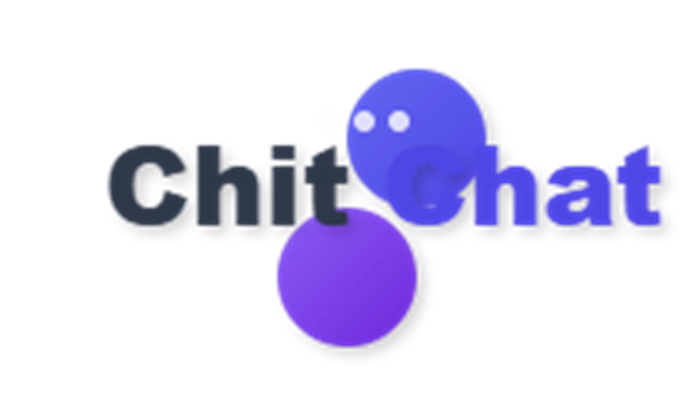
Agenda
Frontend
Backend
Database
SocketIO
PassportJS
Next Iteration
Notes:
For iteration 1, I will be covering the frontend and backend improvements, database implementation, socketIO, passportJS, and next steps for future iterations of our Chit-Chat application!

Slide 3
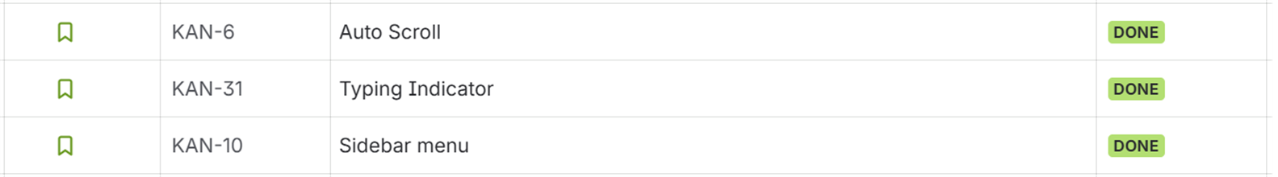
Frontend
Progress during Iteration 1
Notes:
During our first iteration, we’ve made several improvements to the frontend; Real time messaging, auto scroll, typing indicator, and sidebar menu. Each UI component will be demoed later in the presentation.

Slide 4
Frontend Components
Components in the Frontend Layer
Message: Text send or received by user
Message Container: Contains messages from users
Sidebar: Allows user to switch between community and AI chat
Login: Allows user to login and retrieve past chat history
Message Input: Allows user to type and review a message before submitting
Notes:
Our frontend is composed of several components: Messages are text sent or received by the user. The message container contains messages from the current user or other users. Messages have a many to one relationship with message container. The sidebar allows user to switch between chatting with the community or the AI chatbot and is composed of 2 message containers. The login, which is still currently being developed, will allow users to login and retrieve past chat history and customize their profile. The message input allows user to type and review a message before sending it to the community or chatbot.

Slide 5
Backend
Progress during Iteration 1
Notes:
During our first iteration, the backend improvements include implementing our database.

Slide 6


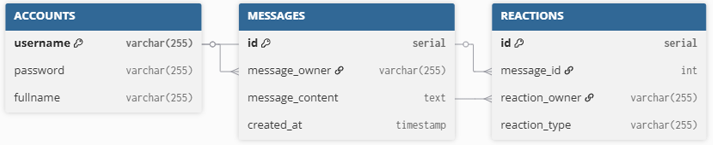
Database Design
Database Management System
Cloud Computing Platform
Tables
Amazon
Web
Services
Accounts
Messages
Reactions
PostgresSQL
Notes:
The Database implementation includes configuring a database instance on Amazon Web Services, using PostgreSQL for its reliability, scalability, and strong support for relational data. Hosting on AWS ensures our database is highly available, backed up automatically, and can scale with future user growth.We then designed the schema for three entities: Account, Messages, amd Reactions

Slide 7
Tables
Accounts
Messages
Reactions
Stores user information such as username, password, and full name
Store all messages sent by users
Stores reaction by users on a specific message
Notes:
The Accounts table stores user information, such as username, password, and full name. The Messages table will store all messages sent by users and the reaction table will store all reactions by users on a specific message. Messages table has a foreign key constraint on accounts username on message_owner. Reactions table has a foreign key constraint on messages id on message_id. As the application grows we may introduce more tables.

Slide 8
Backend Components
Components in the Backend Layer
Socket.IO Controller: Handles events between UI and server. Defines event listeners and event emitters and handles interaction appropriately on each event received
DB Controller: Connects to application database and performs CRUD operations
Notes:
The SocketIO Controller sits on top of Socket.IO and manages the flow of events between the UI and the server. It defines the event listeners and emitters, ensuring each incoming event is processed appropriately and responses are broadcast to the correct users. Acting as a bridge, it coordinates user interactions, other connected clients, and the database, allowing the application to maintain seamless and synchronized communication.
The database controller connects to application database and performs insert update, and delete operations

Slide 9
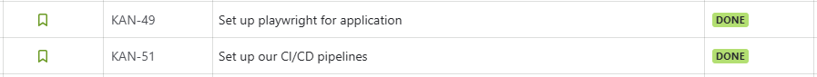
Additional Improvements
Progress during Iteration 1
Notes:
Additional improvements made during this iterations was implementation of playwright testing, CI/CD pipelines, and docker for our application. Playwright was implemented for testing and approx. ~30 automated tests and 9 manual tests were created.
CI/CD pipelines for our project were set up leveraged GitHub Actions to kick off code scanning, integration tests, and build and push our docker image to GHCR. Docker was created for our project; including Dockerfiles for the frontend and backend, and docker-compose for entire application

Slide 10
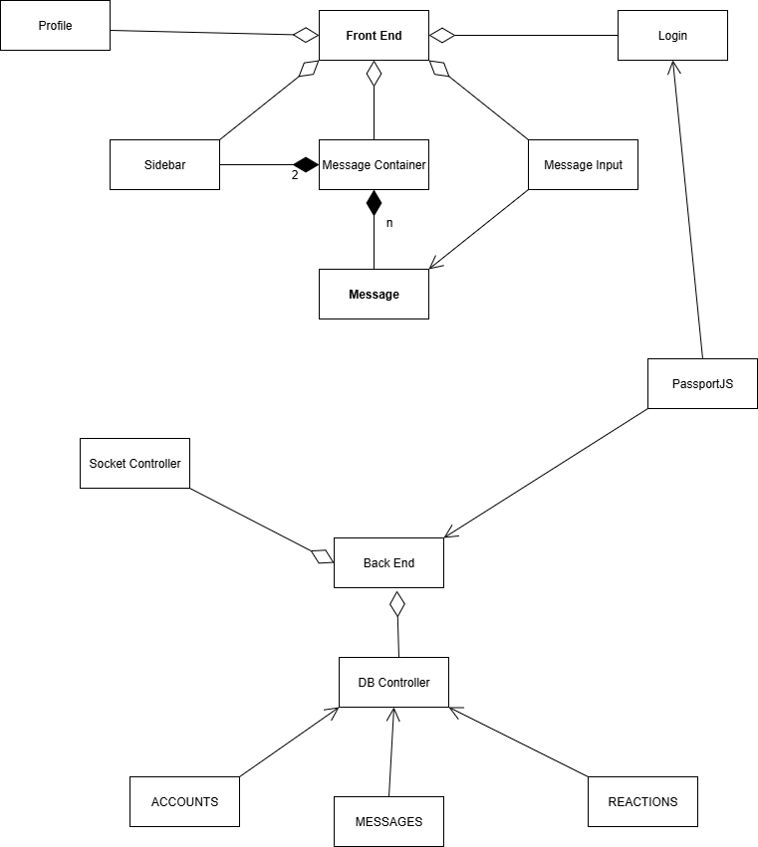
Component Class Relations
Notes:
This is our class diagram of the components of frontend and backend discussed previously.

Slide 11

Security Design
Store users data in a secure AWS hosted database
Hash the user's password
Verify users information against database credentials
Sensitize all user’s messages to prevent db injections
Introduce a rate limit to control message frequency
Notes:
Our UI will be using PassportJS to handle user authentication for our login system. If a user creates a new account we will store users data in a secure AWS hosted database. We will hash the user's password before we store it in our database. Returning users will verify users information against database credentials.
We will also sensitize all user’s messages before we store any of it in our database to prevent db injections. We will introduce a rate limit to control message frequency so it doesn’t crash our application but it still allows a good experience.

Slide 12

Socket.IO
Enables real-time communication between users
Uses event-driven architecture (emit/listen model)
Powers the core chat experience in our application
Notes:
Socket.IO is the core technology that enables real-time communication between users in our chat application. It follows an event-driven architecture, where messages and actions are transmitted through an emit/listen model. This design powers the interactive chat experience, ensuring that updates and messages are shared instantly across all connected clients.

Slide 13
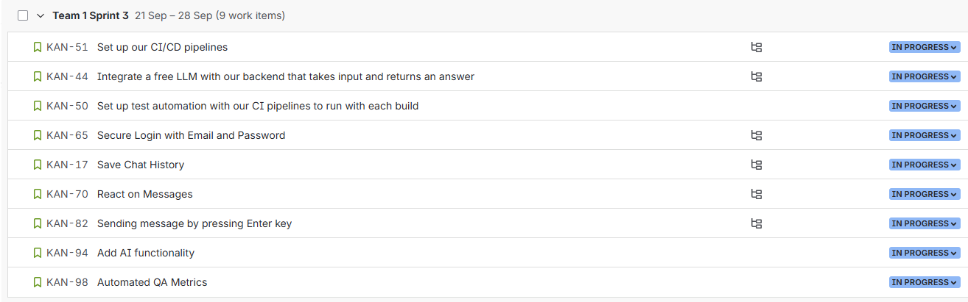
Next Steps
Plans for Iteration 2
Notes:
We have several tasks for our next sprint: continuing to work on testing and CI/CD pipelines, implement AI chatting, create secure login, and several other UI components.

